Slide 1
HIV/AIDS Data Group Project
Review of Python Data Wrangling, Data Insights and Analysis
Duration: 10 mins
Team
Sujata
Emmanuel
Duke
Manpreet
DOHMH HIV/AIDS Report Proposal
Data reported to the HIV Epidemiology and Field Services Program by June 30, 2016.
All data shown are for people ages 13 and older.
Borough-wide and citywide totals may include cases assigned to a borough with an unknown UHF or assigned to NYC with an unknown borough, respectively. Therefore, UHF totals may not sum to borough totals and borough totals may not sum to citywide totals.

Slide 2
Data Wrangling Steps
Found a large AIDS/HIV dataset from the DOHMH that included several years worth of HIV and AIDS diagnoses, death, linkage to care and suppression separated by borough, gender, age and race
Imported pandas, numpy, seaborn and matplotlib for statistical review and visualization.
Given that our dataset included placeholders for 0 values, we’ve cleaned up this data by creating new data sets and removing certain values:
‘99999’ placeholders for values with denominators of 0
“All” as a category so that we could analyze data by categories.
Borough
Race
Gender
Age

Slide 3
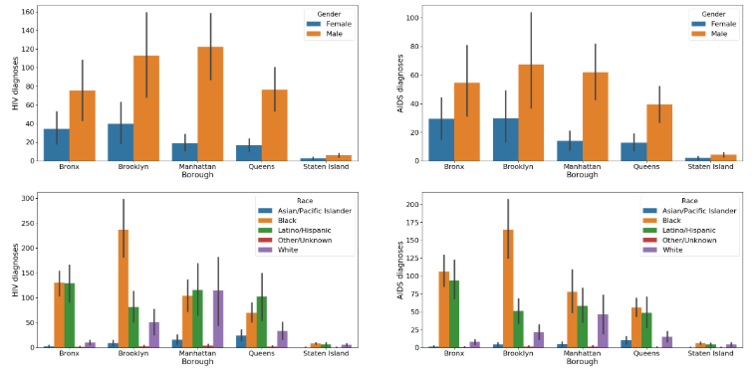
Race vs. Gender by Borough |Sujata
Data Insight :
According to this data, we can see that males had a higher HIV and AIDS diagnoses compared to women in all Boroughs.

Slide 4
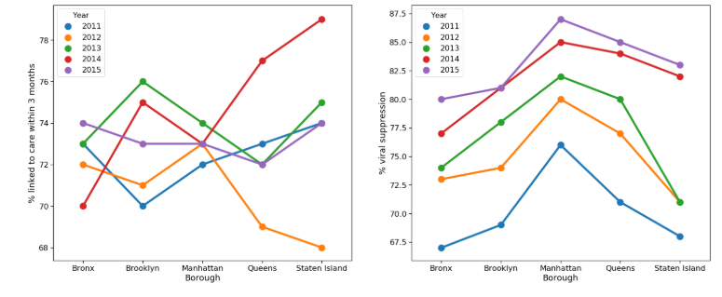
Borough Analysis |Sujata
Data Insight :
It appears that greater linkage to care within 3 months led to a higher percentage of viral suppression.

Slide 5
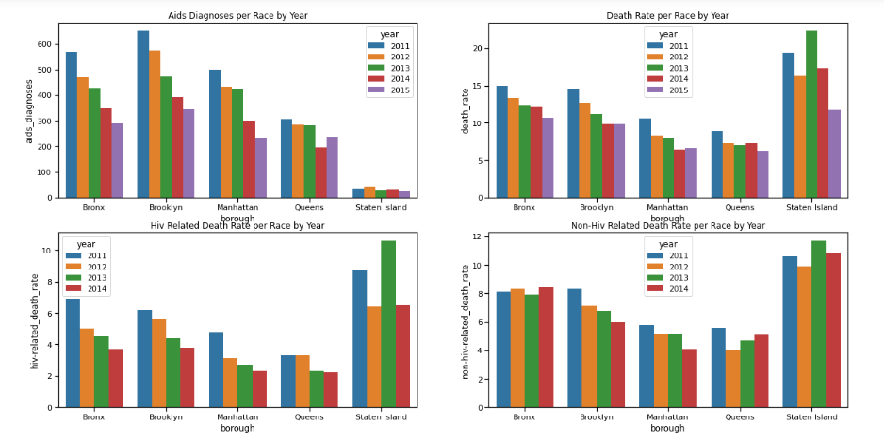
Death Rate by Borough | Emmanuel
With AIDS Diagnosis, Brooklyn and Bronx were the highest borough to be affected, followed by Manhattan and Queens.
With the Death Rate, communities in Staten Island were the most impacted. In addition, Staten Island had the highest HIV and Non-HIV related death rate with the death rate count in 2013.
Data Insight :

Slide 6
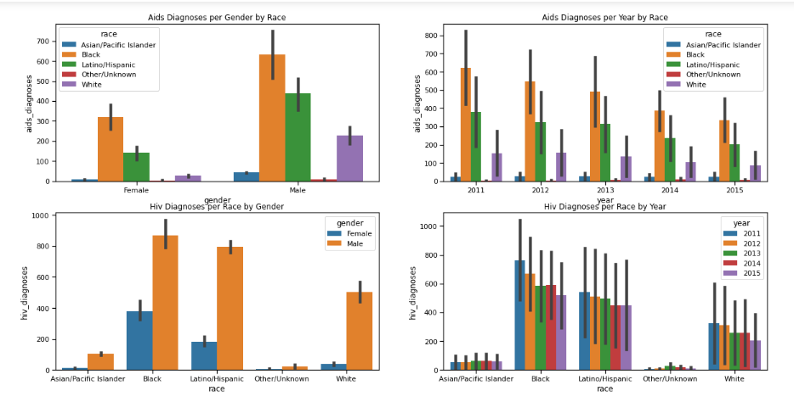
Race Analysis |Emmanuel
With AIDS Diagnosis, Black males and females were the highest demographic to be affected, followed by Latino males and White Males.
With HIV Diagnosis, Black communities again were the most impacted beginning with the highest diagnoses count in 2011. Similar trends follow in the Latino/Hispanic community followed by White.
Data Insight :

Slide 7
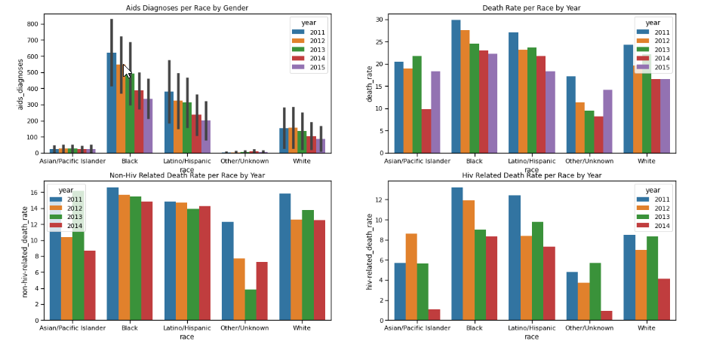
Race Analysis |Emmanuel
Data Insight :
With Death Rate, the Black, Latino and White communities in were the most impacted with high rates in 2011.
All three race also had highest HIV and Non-HIV related death rate.

Slide 8
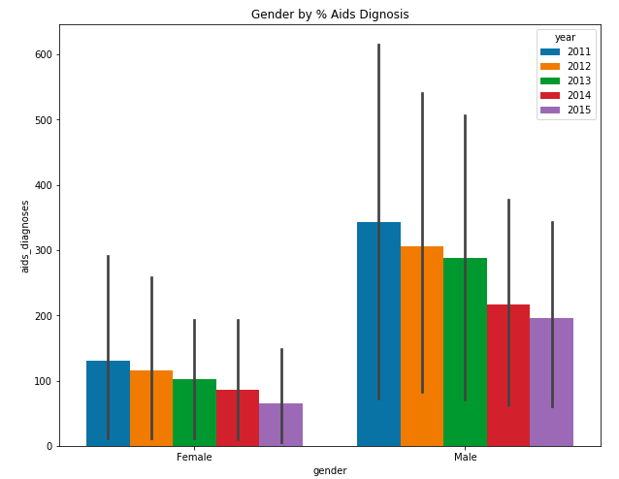
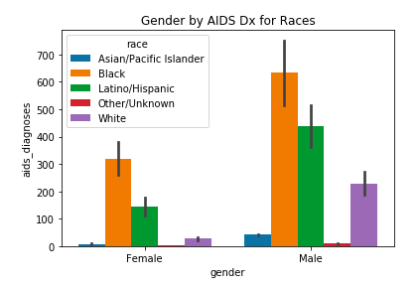
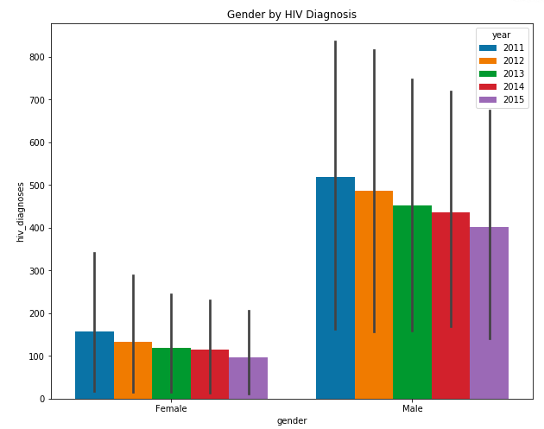
Gender Analysis |Duke
Data Insight :
Over the 5-year period, men have a higher diagnosis of HIV than women.

Slide 9
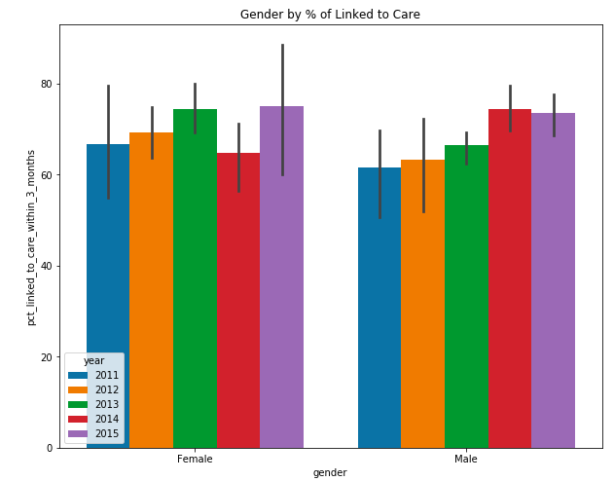
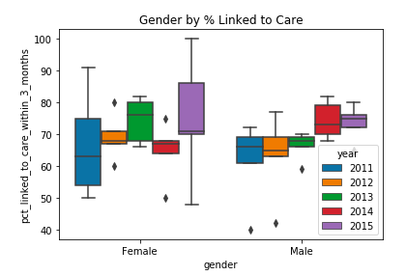
Gender Analysis |Duke
Data Insight :
Over the 5-year period, Women seem to be linked to Care much better than men within the first 3-months of HIV Diagnosis

Slide 10
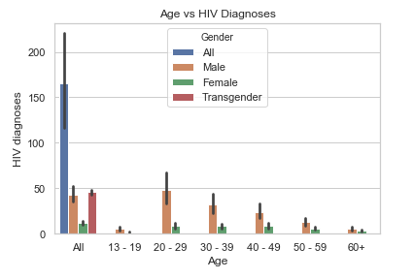
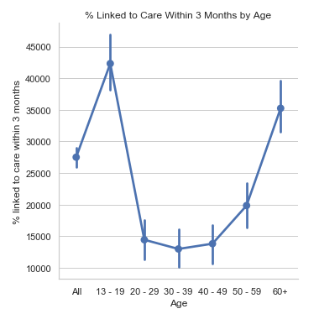
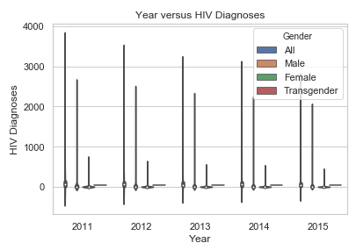
Age Analysis |Manpreet
Data Insight :
The hardest hit age and gender group were males in their 20-29 years of age, followed by older men.
There’s an inverse relationship between the above graph with this one – showing that younger subjects with HIV Diagnoses were least likely to be linked to care within the first three months.
2011 had the most HIV Diagnoses and it continued to drop each year afterwards.

Slide 11

Data Conclusions
Through our analysis, we found that black males, between the age range of 20-29 years in Brooklyn, were the highest reported individuals diagnosed with HIV. Latino/Hispanic and white communities followed respectively.
This trend decreases yearly across all boroughs.
We also found that older individuals and women were more likely to be linked up to care within the first three months of diagnoses which also helped viral suppression percentage.
Interestingly, we also found that non-HIV related death rate and HIV related death rate was highest in Staten Island, although it had the lowest HIV and AIDS incidence.

